Slide 1
Biometric Fingerprint-Based Employee Attendance and Monitoring System
Vavasoft
Vavasoft | Biometric Attendance & Monitoring System

Slide 2
The Team
👑 TEAM LEADER
Acosta, Juliana Marie
👤
👤
👤
Seno
Villanueva
Calvo
👤
👤
👤
Roldan
Carijutan
Montenegro
Vavasoft | Biometric Attendance & Monitoring System

Slide 3
Project Instructor
🎓
Project Instructor
Mrs. Eleonor Rodriguez
Vavasoft | Biometric Attendance & Monitoring System

Slide 4
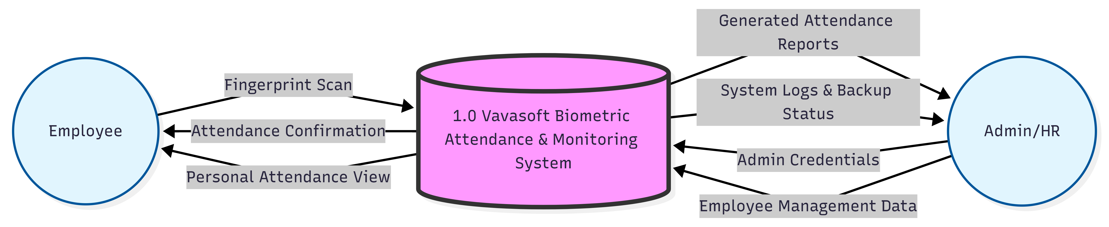
Data Flow Diagram
Vavasoft | Biometric Attendance & Monitoring System

Slide 5
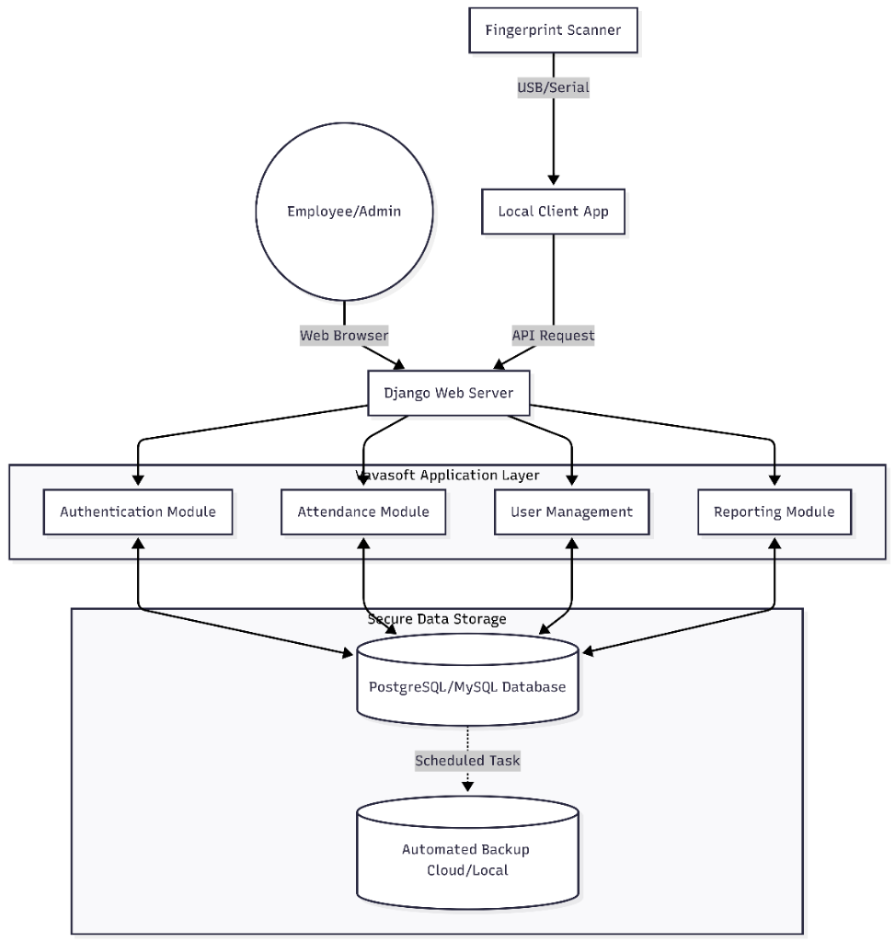
System Architecture
Hardware ↔ Software ↔ Database
▶ Fingerprint Scanner connects via USB/Serial to a local Python client application
▶ Client sends API requests with biometric data to the Django Web Server
▶ Django routes to Authentication, Attendance, User Mgmt, and Reporting modules
▶ All data persisted in PostgreSQL/MySQL with automated cloud & local backups
Vavasoft | Biometric Attendance & Monitoring System

Slide 6
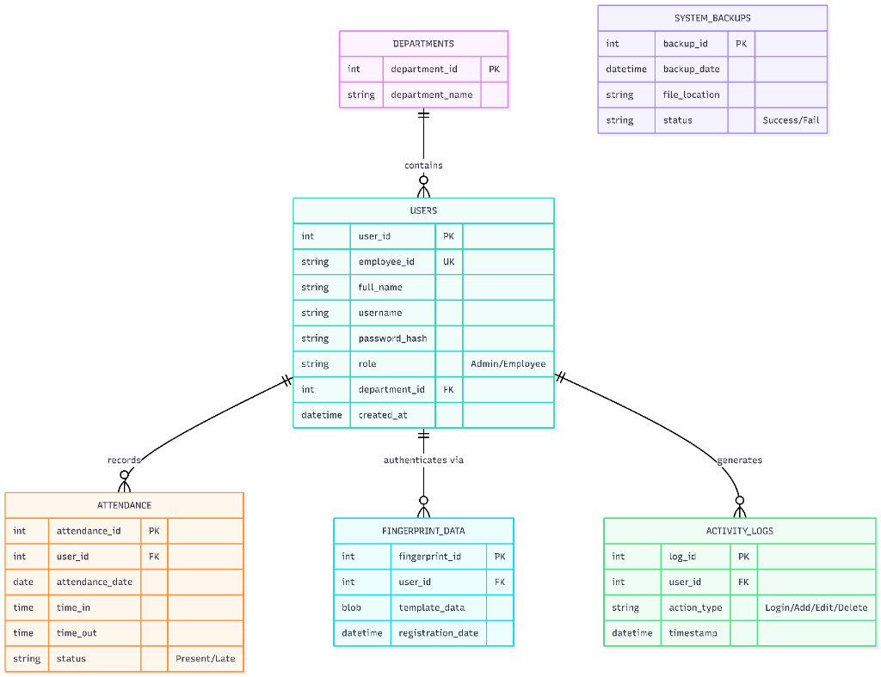
Database Design (ERD)
Entity-Relationship Diagram
▶ DEPARTMENTS → USERS Employees mapped to their specific team/dept
▶ USERS → FINGERPRINT_DATA Unique biometric template per employee
▶ USERS → ATTENDANCE Daily time-in/time-out records with status
▶ USERS → ACTIVITY_LOGS Full audit trail: Login / Add / Edit / Delete
▶ SYSTEM_BACKUPS Scheduled backup records (Success / Fail)
Vavasoft | Biometric Attendance & Monitoring System

Slide 7
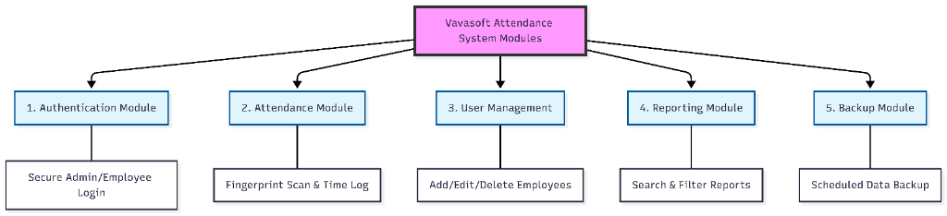
Module Design
5 Core Application Modules
🔐
🖐
👥
📊
💾
1. Authentication
2. Attendance
3. User Mgmt
4. Reporting
5. Backup
Secure Admin & Employee login
Fingerprint scan & time log
Add / Edit / Delete employees
Search & filter HR reports
Scheduled automated data backup
Vavasoft | Biometric Attendance & Monitoring System

Slide 8
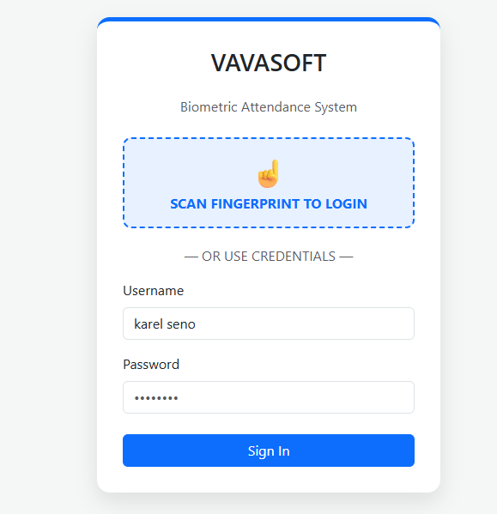
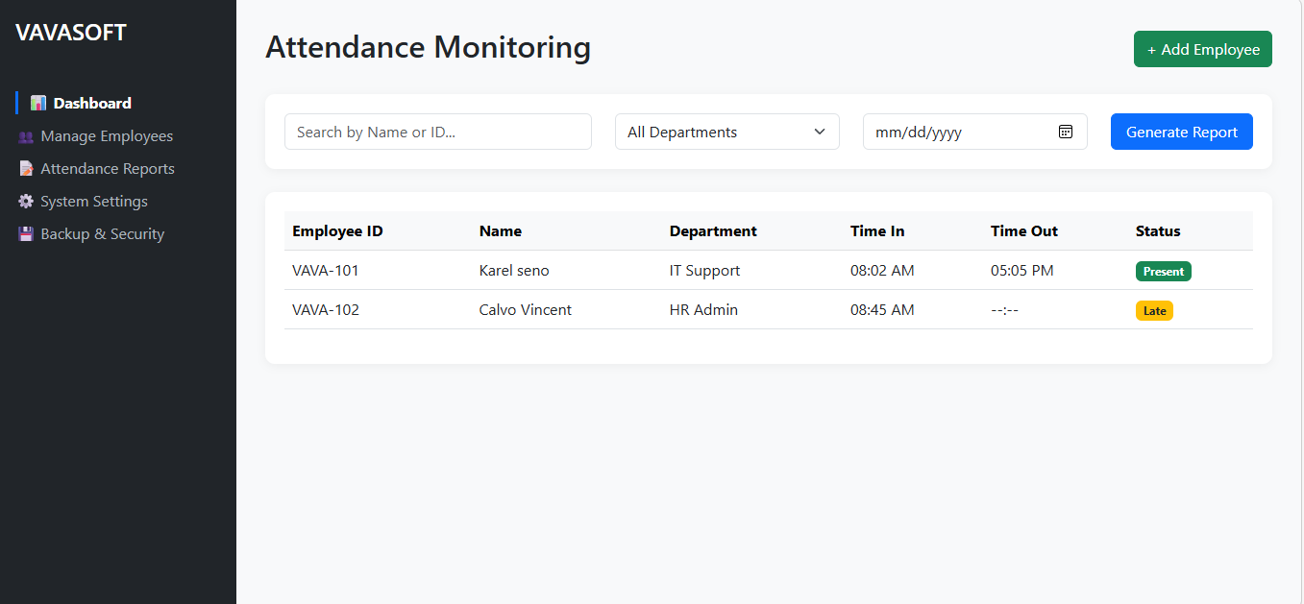
UI Design
Web-Based Vavasoft Interface
🏠 Home
👤 Users
🖐 Attend.
📊 Reports
💾 Backup
Vavasoft | Biometric Attendance & Monitoring System

Slide 9
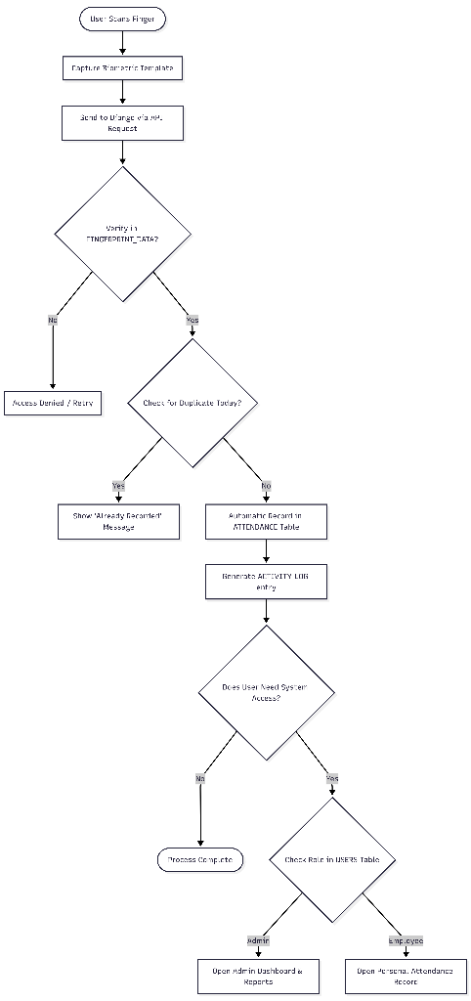
System Logic Flowchart
Fingerprint Scan → Authentication → Attendance Recording
▶ User scans finger → template captured and sent to Django via API
▶ Django checks template against FINGERPRINT_DATA table
▶ If no match → Access Denied / Retry
▶ If match → Duplicate check for today
▶ If no duplicate → Attendance recorded in ATTENDANCE table + Activity Log
▶ Role check → Admin: Dashboard & Reports Employee: Personal Records
Vavasoft | Biometric Attendance & Monitoring System

Slide 10
Security & Data Integrity
Safeguards built into every layer of the system
🚫
🔑
💾
📋
Anti-Buddy Punching
Role-Based Access Control
Automated Daily Backups
Full Activity Audit Log
Physical fingerprint presence required. Cannot clock-in for another employee. Prevents time-fraud at the source.
Admins access all dashboards & reports. Employees see only their own records. Least-privilege security principle.
Scheduled tasks push data to cloud and local storage every night. Success/Fail status recorded in DB.
Every Login, Add, Edit, Delete action is timestamped and logged. Complete traceability for compliance.
Vavasoft | Biometric Attendance & Monitoring System

Slide 11
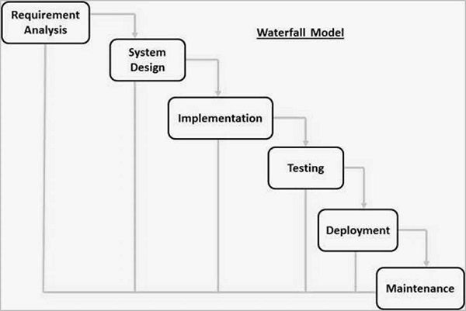
Methodology – Waterfall Model
✅ Requirements Analysis
✅ System Design
⏭ Implementation (Coding)
⬜ Testing
⬜ Deployment
⬜ Maintenance
→
→
→
→
→
✅ Current Status: System Design Phase
Vavasoft | Biometric Attendance & Monitoring System

